Slide 1


Power BI - Part II
mintesnot

Slide 2

DAX
DAX Formula
DAX Functions
Row Context
Filter Context
Calculated Column
Measures
Publishing Power BI Report
Power BI Workspace
Power BI Dashboard

Slide 3
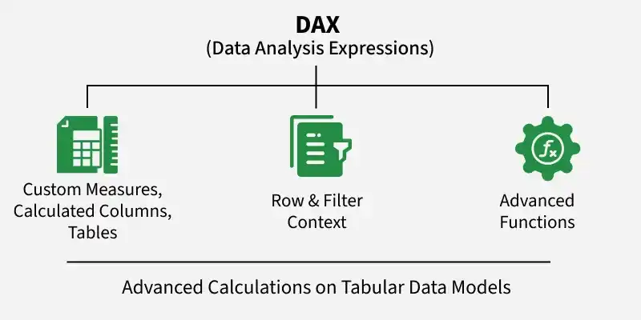
DAX – Data Analysis Expressions
Data Analysis Expression (DAX) is a useful formula and query language used to perform advanced calculations on tabular data models.
It enables dynamic, context-aware analysis that goes beyond traditional spreadsheet formulas.
Used to create custom measures, calculated columns & tables.
Supports complex calculations with row and filter context.
Provides advanced functions not available in standard Excel formulas.

Slide 4
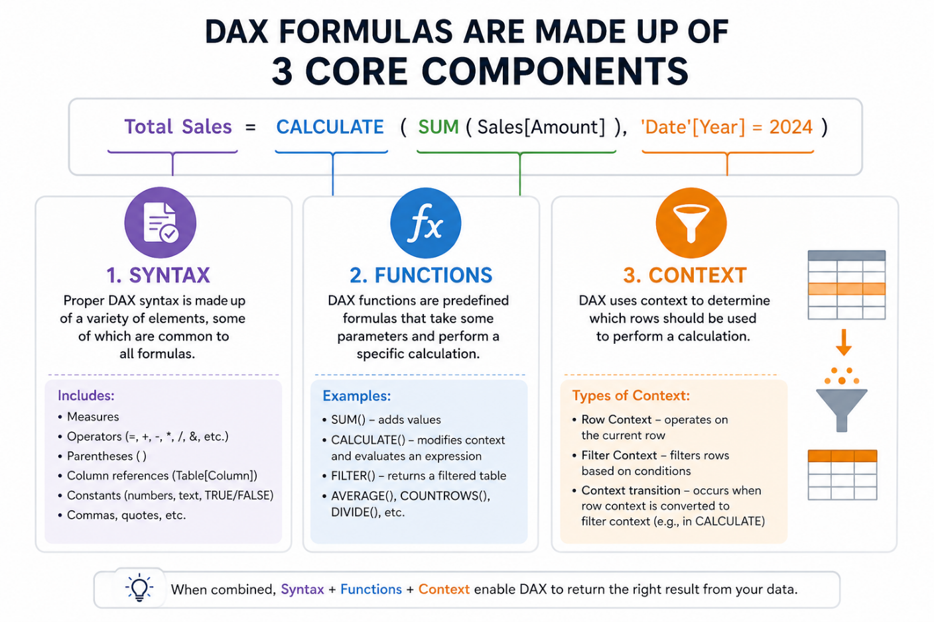
DAX Formula
DAX formulas are made up of 3 core components.
Syntax – Proper DAX syntax is made up of a variety of elements, some of which are common to all formulas.
Functions – DAX functions are predefined formulas that take some parameters and perform a specific calculation.
Context – DAX uses context to determine which rows should be used to perform a calculation.

Slide 5
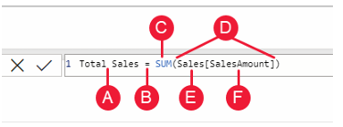

…
A: The measure name, Total Sales.
B: The equals sign operator (=), which indicates the beginning of the formula. When calculated, it will return a result.
C: The DAX function SUM, which adds up all of the numbers in the Sales[SalesAmount] column.
D: Parenthesis (), which surround an expression that contains one or more arguments. Most functions require at least one argument. An argument passes a value to a function.
E: The referenced tables, Sales.
F: The referenced column, [SalesAmount], in the Sales table. With this argument, the SUM function knows on which column to aggregate a SUM.

Slide 6
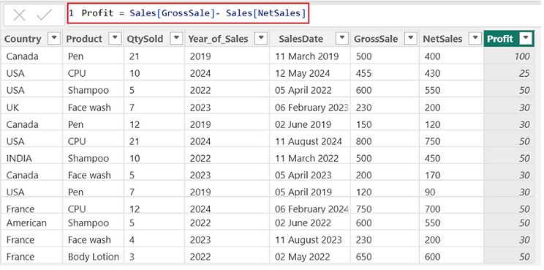
Row Context & Filter Context
Row Context:
It is when Power BI looks one row at a time in a table while doing a calculation.
It automatically happens when you’re working with calculated columns or functions that go through each row, like SUMX, AVERAGEX, MINX, MAXX, FILTER, etc.
Row context refers to the situation where Power BI evaluates an expression one row at a time within a table – but does so for each row.
While each row is processed individually, the calculation ultimately includes all rows (one by one).

Slide 7
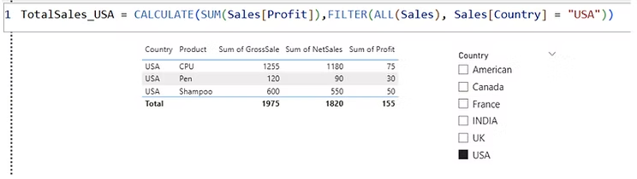
Row Context & Filter Context
Filter Context:
Filter context refers to the set of filters applied to a calculation before evaluation.
It is influenced by slicers, filters, and relationships in the data model.
It determines which rows of data are considered when calculating a measure.
It decides which data should be included in a calculation based on filters, slicers, visuals, and relationships in your data model.

Slide 8
Row Context Vs. Filter Context
Feature | Row Context | Filter Context
Applied to | Individual rows | Filtered data set
Created by | Iterative functions (X functions) | Slicers, filters, relationships
Example Function | SUMX, FILTER | CALCULATE, ALL
Can Modify? | No, unless used inside CALCULATE | Yes, using CALCULATE and filter functions

Slide 9
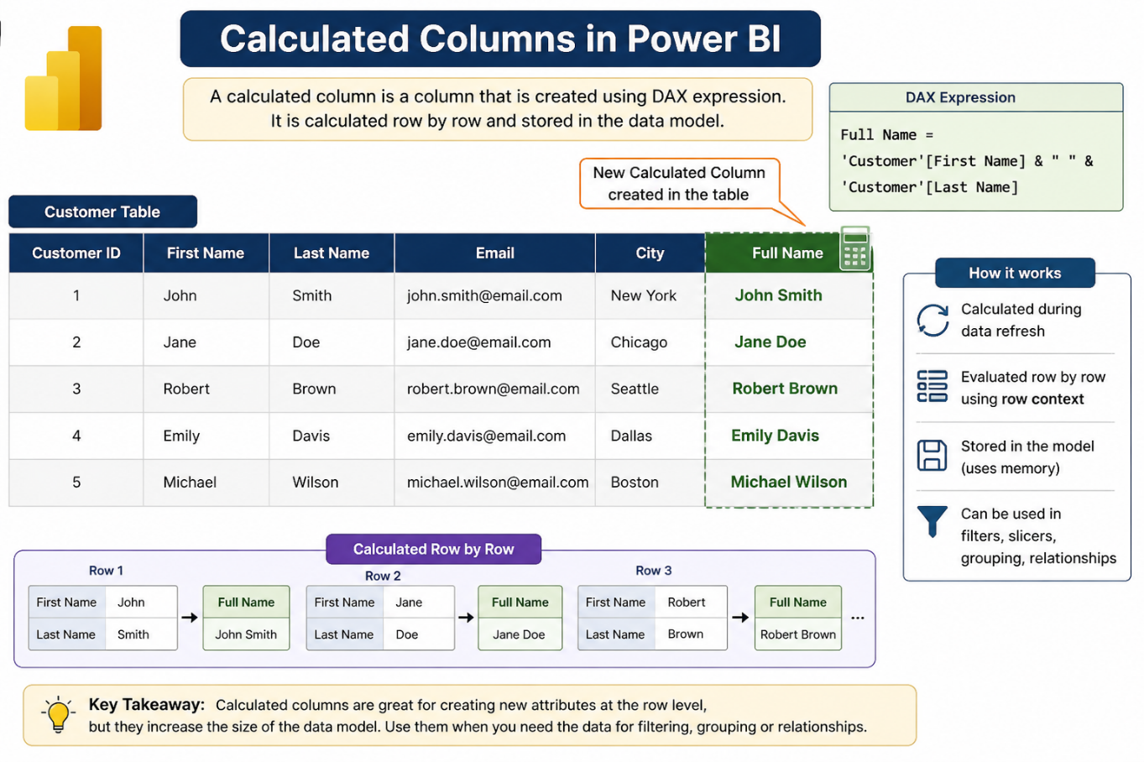
Calculated Columns
A calculated column is a column you create using DAX.
It is computed row by row and stored in the data model.
Each row gets its own calculated value.
Perform row-level calculations.
It is used to prepare data for filtering, grouping & relationships.
These are new columns added to a table in the data model.
The value of a calculated column is computed row by row, and the results are stored in the model.

Slide 10
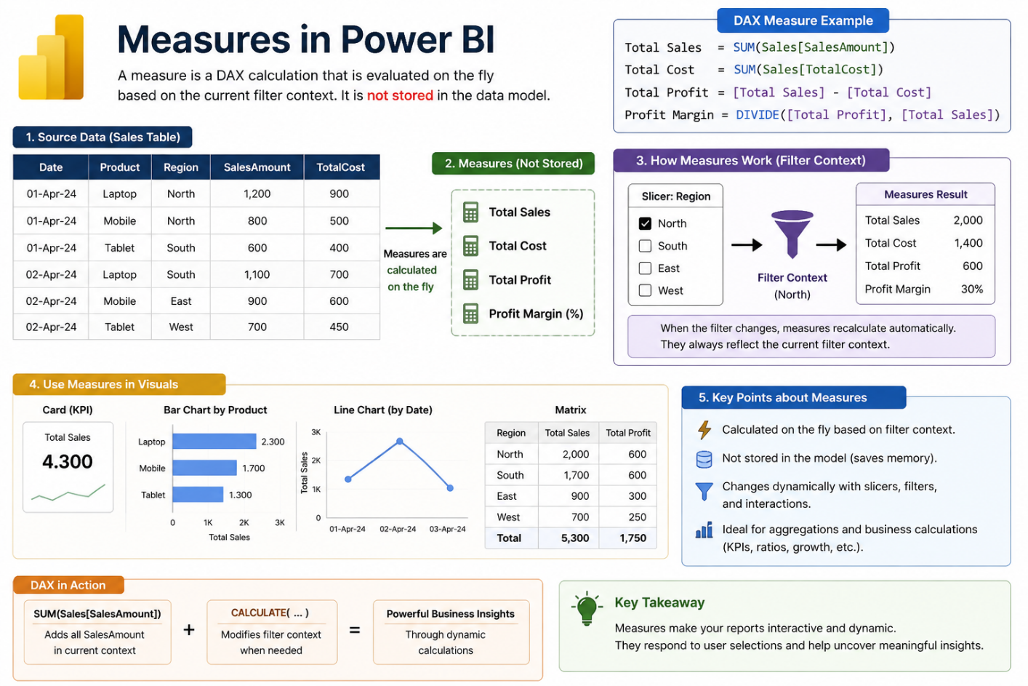
Measure
A calculated column is a column you create using DAX.
It is computed row by row and stored in the data model.
Each row gets its own calculated value.
Perform row-level calculations.
It is used to prepare data for filtering, grouping & relationships.
These are new columns added to a table in the data model.
The value of a calculated column is computed row by row, and the results are stored in the model.

Slide 11
… Context
Context
Calculated Columns – Evaluated in a row context. Each row is processed individually to compute the value.
Example: Total Price = Sales[Quantity] * Sales[Price]
Measures – Evaluated in a filter context, which means their results can change based on user interactions.
Example: Total Sales SUM(Sales[Total Price])

Slide 12
… Storage
Storage
Calculated Columns – The results are stored in the data model, which can increase the size of the model.
Once calculated, the values are fixed until the data is refreshed.
Measures – Not stored in the model. The calculation is performed each time the measure is referenced in a report.
More efficient in terms of memory usage, especially for large datasets.

Slide 13
Calculated Columns Vs. Measure
Feature | Calculated Column | Measure
Calculation | Row-by-row | Aggregated
Storage | Stored in table | Not stored
Context | Row context | Filter context
Performance | Slower with large data | More efficient

Slide 14
COUNT functions in Power BI
COUNT: It returns the total number of items in the column.
COUNTROWS: It returns the number of rows in the table.
DISTINCTCOUNT: It returns the number of distinct values in the values column.
COUNTA: It counts the number of items in a column, that is not empty i.e. occupied.
COUNTBLANK: It counts blank cells in a single column.
Syntax: COUNT(<column name>)
Syntax: COUNTROWS(<table name>)
Syntax: DISTINCTCOUNT(<column name>)
Syntax: COUNTA(<column name>)
Syntax: COUNTBLANK(<column name>)

Slide 15
DATETIME functions in Power BI
DATE: Returns a date value from year, month and day.
HOUR: Returns the hour as a number from 0 to 23.
TODAY: It returns today’s date.
WEEKDAY: It returns values between 1-7 where according to the day number in a week where 1 refers to Sunday and 7 is Saturday..
NOW: It returns the current date and time in datetime format.
Syntax: DATE(<year>, <month>, <day>)
Syntax: HOUR(<datetime>)
Syntax: TODAY()
Syntax: WEEKDAY(<date>, <return_type>)
Syntax: NOW()

Slide 16
AGGREGATE functions in Power BI
MIN: Finds the minimum value in a given column or between two expressions.
MAX: Returns the maximum value in a given column or between two expressions.
SUM: The formula adds the values in a column to product a total.
AVERAGE: It takes columns of data and returns the average.
MINX: Calculates the minimum value after evaluating each row expression in a table.
Syntax: MIN(<column>) or MIN(<exp1>,<exp2>)
Syntax: MAX(<column>) or MAX(<exp1>, <exp2>)
Syntax: SUM(Sales[Amount])
Syntax: AVERAGE(Sales[Amount])
Syntax: MINX(<table>, <expression>)

Slide 17
Logical functions in Power BI
AND: Combines 2 expressions logically.
OR: This function performs the logical disjunction on 2 expressions.
NOT: Negates the given expression logically.
IF: It checks IF a criterion is true and returns one value if it is and another value if it is not.
Syntax: AND(<logical1>, <logical2>)
Syntax: OR(<logical1>, <logical2>)
Syntax: NOT(<logic>)
Syntax: IF(<logical_test>, <value_if_true>, value_if_false)

Slide 18
MATH functions in Power BI
ABS: Returns the absolute value.
FACT: Returns the factorial of the number.
EXP: Calculates the exponential value of a number.
ROUND: Rounds a number to a specified number of decimal.
POWER: Raises a number to a specified power.
Syntax: ABS([number])
Syntax: FACT([number])
Syntax: EXP([Number])
Syntax: ROUND([Number], [NumDigitsAfterDecimal])
Syntax: POWER([Number], [POWER])

Slide 19
…
LOG: Calculates the logarithm of a number to a specified base.
SQRT: Calculates the square root of a number.
MOD: Returns the remainder of a division operation.
SIN, COS, TAN: Calculates the trigonometric sine, cosine and tangent of an angle, respectively.
Syntax: LOG([Number], [Base])
Syntax: SQRT([Number])
Syntax: MOD([Dividend], [Divisor])
Syntax: SIN([Angle]), COS([Angle]), TAN([Angle])

Slide 20
TEXT functions in Power BI
CONCATENATE: Joins two strings together.
FIXED: Rounds off numbers to a given decimal.
REPLACE: Replace the characters with part of a string.
UPPER: Converts a text string to all uppercase letters.
LOWER: Converts a text string to all lowercase letters.
SEARCH: Returns the number of the character at which a searched character or text string is first appeared.
Syntax: CONCATENATE(<text_1>, <text_2>)
Syntax: FIXED([Number], [NumDigitsAfterDecimal], [IncludeLeadingZeroes])
Syntax: REPLACE(<old_text>, <start_num>, <num_chars>, <new_text>)
Syntax: UPPER(<text>)
Syntax: UPPER(<text>)
Syntax: SEARCH(<find_text>, <within_text>[, [<start_num>][,<NotFoundValue>]])

Slide 21
…
CONCATENATE: Joins two strings together.
FIXED: Rounds off numbers to a given decimal.
REPLACE: Replace the characters with part of a string.
UPPER: Converts a text string to all uppercase letters.
LOWER: Converts a text string to all lowercase letters.
SEARCH: Returns the number of the character at which a searched character or text string is first appeared.
Syntax: CONCATENATE(<text_1>, <text_2>)
Syntax: FIXED([Number], [NumDigitsAfterDecimal], [IncludeLeadingZeroes])
Syntax: REPLACE(<old_text>, <start_num>, <num_chars>, <new_text>)
Syntax: UPPER(<text>)
Syntax: UPPER(<text>)
Syntax: SEARCH(<find_text>, <within_text>[, [<start_num>][,<NotFoundValue>]])

Slide 22
Statistical functions in Power BI
MEDIAN: Returns the median value in a column.
MODE: Returns the mode (most frequently occurring value) in a column.
AVERAGE: Calculates the average of a column of numeric values.
STDEV.P: Calculates the population standard deviation of a column.
STDEV.S: Calculates the sample standard deviation of a column.
SEARCH: Calculates the population variance of column.
Syntax: MEDIAN([Column])
Syntax: MODE([Column])
Syntax: AVERAGE([Column])
Syntax: STDEV.P([Column])
Syntax: STDEV.S([Column])
Syntax: VAR.P(Column)

Slide 23
Filtering functions in Power BI
CALCULATE: Modifies the filter context of a calculation.
FILTER: Returns a table filtered by a condition.
Syntax: CALCULATE(expression, filter1, filter2, …)
Syntax: FILTER(table, condition)

Slide 24
Operators in DAX
DAX provides a variety of operators that you can use to perform calculations & manipulate data.
These operators can be categorized into several types: arithmetic, comparison, logical, text concatenation, and more.
Arithmetic Operators – These operators are used to perform mathematical calculations.
Operator | Description | Example
+ | Addition | Sales[Revenue] + Sales[Cost]
- | Subtraction | Sales[Revenue] – Sales[Cost]
* | Multiplication | Sales[Quantity] * Sales[Price]
/ | Division | Sales[Quantity] / Sales[Quantity]
^ | Exponentiation | Power (2, 3) (equivalent to 2323)

Slide 25
…
Comparison Operators – These operators compare two values and return a Boolean result (TRUE or FALSE).
Operator | Description | Example
= | Equal to | Sales[Quantity] = 10
<> | Not equal to | Sales[Quantity] <> 10
> | Greater than | Sales[Revenue] > 1000
< | Less than | Sales[Revenue] < 1000
>= | Greater than or equal to | Sales[Revenue] >= 1000
Text Operators – These operators are used for string manipulation & concatenation.
Operator | Description | Example
& | Concatenation | Sales[Product] & " - " & Sales[Category]

Slide 26
…
Logical Operators – These operators are used to combine multiple conditions.
Operator | Description | Example
AND | AND | Returns TRUE if both conditions are TRUE.
NOT | NOT | Reverses the logical value of a condition.
OR | OR | A Boolean value. The value is TRUE if any of the two arguments is TRUE; the value is FALSE if both the arguments are FALSE.
Special Operators – These operators serve specific purposes in DAX calculations.
Operator | Description | Example
IN | Checks for existence in a list | Sales[Category] IN {“Electronics”, “Clothing}
BLANK | Represents missing or empty values | IF(Sales[Revenue] = 0, BLANK(), Sales[Revenue])

Slide 27
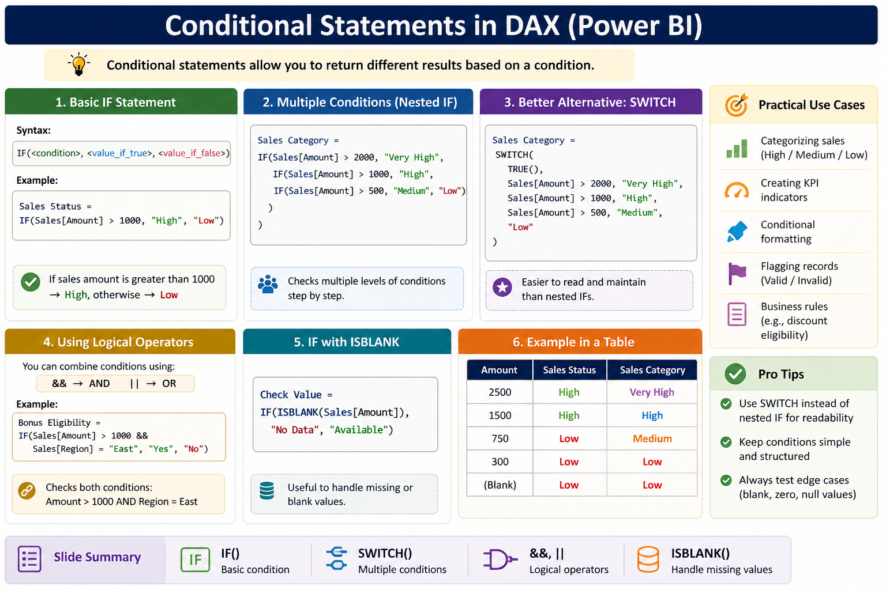
Conditional Statements
In DAX, conditional statements allow you to perform different actions based on certain conditions.
The primary way to handle conditional logic in DAX is through the IF function, which evaluates a logical test and returns different values for TRUE and FALSE outcomes.
For more complex scenarios involving multiple conditions, the SIWTCH function is often preferred to avoid nested IF statements.

Slide 28
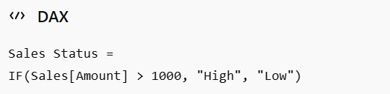
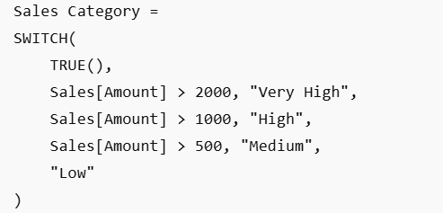
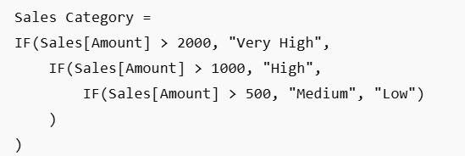
…
Basic IF
Syntax:
Example:
SWITCH
Read and maintain than nested IFs.
Example:
Multiple Conditions (NESTED IF)
Checks multiple levels of conditions step by step.
Example:

Slide 29


…
Using Logical Operators
You can combine conditions using.
&& -> AND
|| -> OR
Example:
IF with ISBLANK
Example:

Slide 30
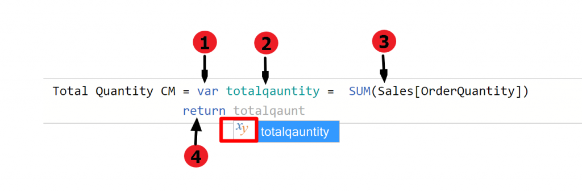
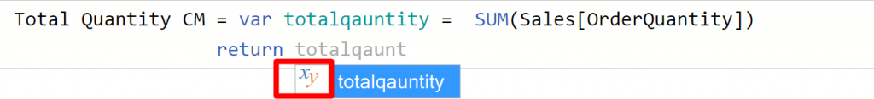
Variables in DAX
Variables are created using the keyword ‘var’, designating a descriptive name, assigning an expression and returning the value.
The parts of the variable include:
Keyword identifier
Variable name
Expression
Return statement
Once the variable is created, Power BI intelligently detects the variable and it can be verified by ‘xy’ symbol.

Slide 31
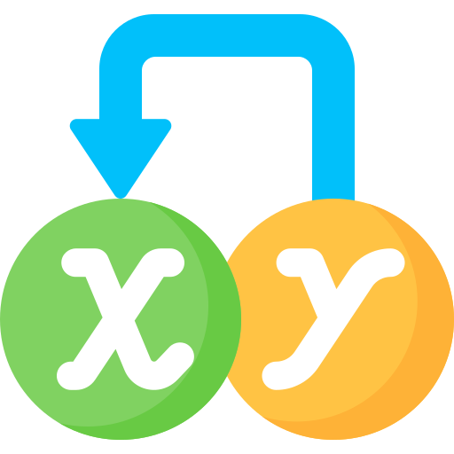
… Features of a variable
Variables can be used for scalar values or tables.
Variables can be defined by other variables.
Variables make the code easier to read.
Variables are evaluated right where they are defined.
Variables can be defined anywhere in an in-line DAX expression.
Variables improve the performance by in avoiding duplicating computations.
Variables might help avoid issues with row and filter context mistakes this is because they are evaluated where they are defined.

Slide 32
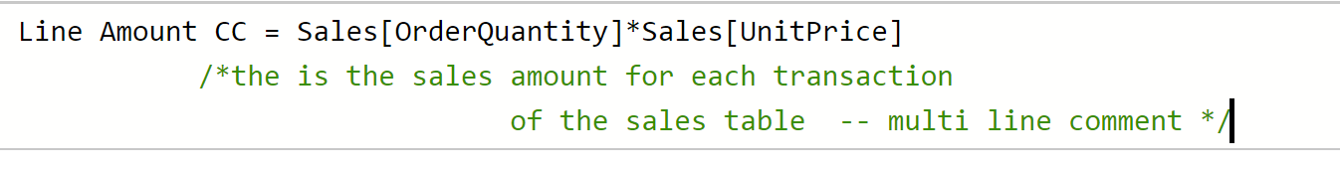

Comments in DAX
Comments are added in the DAX expression to make code understandable.
The lines are executed by the DAX optimizer and therefore act as ‘sticky notes’ in the code snippet.
Single Line Comments
Begins with the ‘//’ symbol and are automatically terminated as the line ends.
Span one line only.
Multi Line Comments
Can be written on more than one line.
They begin with ‘/*’ and ended with ‘*/’.
Everything written inside the two identifiers is not executed by the DAX optimizer.

Slide 33
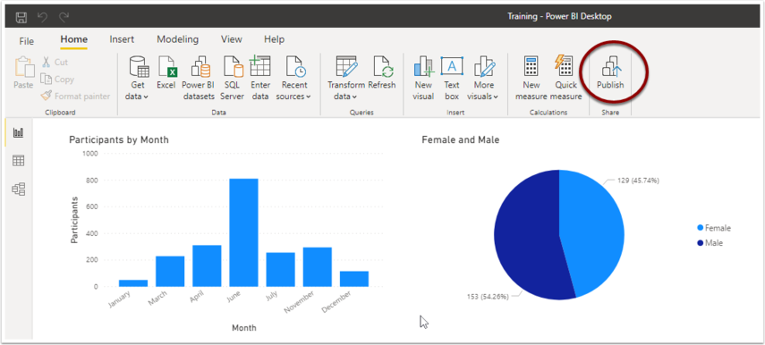

Publishing Power BI Reports
Microsoft Power BI provides a seamless workflow for creating and sharing interactive reports and dashboards.
After designing a report using Power BI Desktop, you can publish it to Power BI Online to share it with your team or a wider audience.
In Power BI Desktop, click on the “Publish” button in the Home tab of the ribbon.

Slide 34
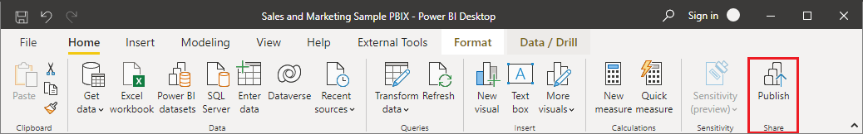
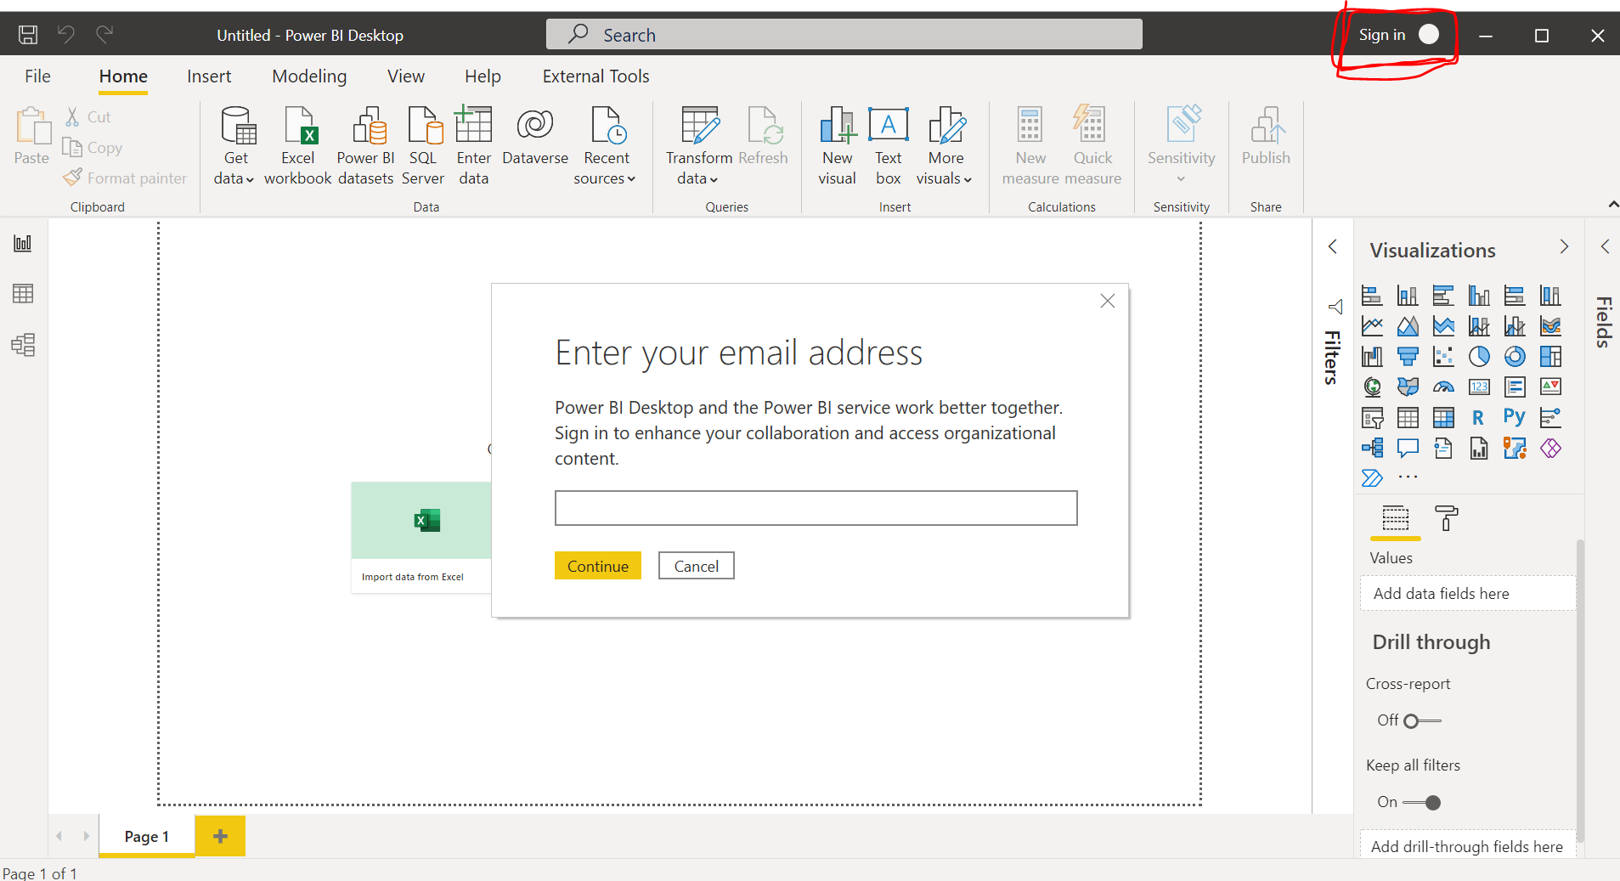
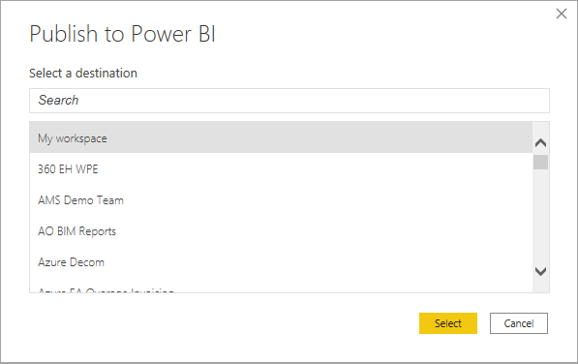
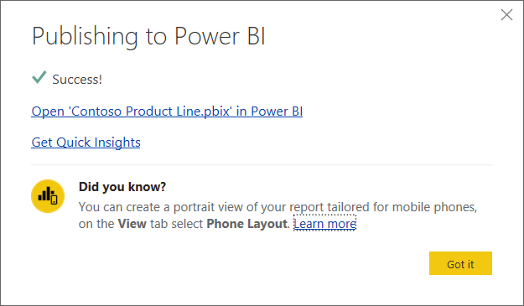
… Steps
In Power BI Desktop, choose File > Publish > Publish to Power BI or select Publish on the Home ribbon.
Sign in to Power BI if you aren’t already signed in.
Select the destination. You can search your list of available workspaces to find the workspace into which you want to publish. The search box lets you filter your workspaces. Select the workspace, and then click the Select button to publish.
When publishing is complete, you receive a link to your report. Select the link to open the report in your Power BI site.

Slide 35
Sharing Methods
🚀Sharing Method | ✅Pros | ❌Cons
📒 .pbix file | No account needed | Must have Power BI Desktop
🌩️ Power BI service | Easy online sharing | Requires Power BI account

Slide 36
Features of Power BI Publish
Public access: Publish to Web enables users to share content on a publicly accessible website, thus allowing a wider audience to benefit from the shared insights.
Automatic updates: Published reports & dashboards can be set to automatically update, ensuring that viewers always have access to the latest data.
Customizable view modes: Users can customize the view modes of their published content, allowing them to control how viewers interact with and explore the data.
Increased accessibility: Data insights are available directly on your website.
Enhanced engagement: Data-driven decision-making is accessible to a broader audience.

Slide 37
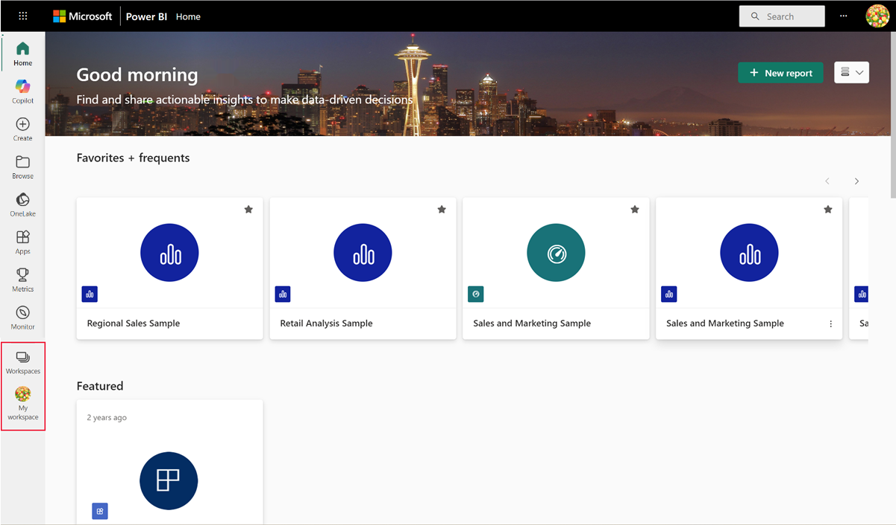
Power BI Workspace
Power BI Workspace refers to a collaboration hub where you and your team can collaborate to create interactive dashboards and reports.
To share your content with others in Power BI, you can begin by creating what is essentially another designated area, referred to as a Workspaces.
These workspaces are alternatively known as “App workspaces” or “Organizational workspaces”.
Workspaces are most effectively utilized as collaborative spaces where teams can efficiently share and collaborate on content.

Slide 38

Types of Power BI Workspaces
My Workspace
A personal workspace where an individual can store and work on their own reports and datasets.
App Workspaces
Workspaces that allow multiple users to collaborate on a shared content.
These are used to create, manage, and distribute apps containing reports and dashboards to a larger audience.

Slide 39
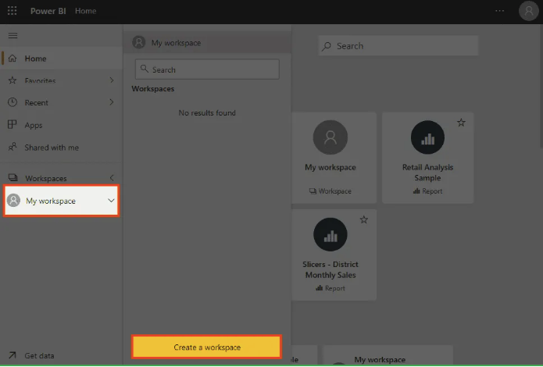
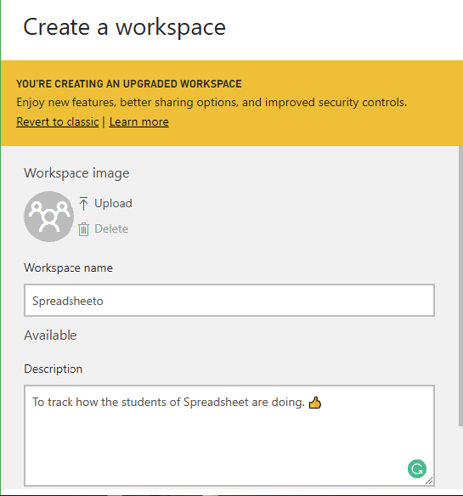
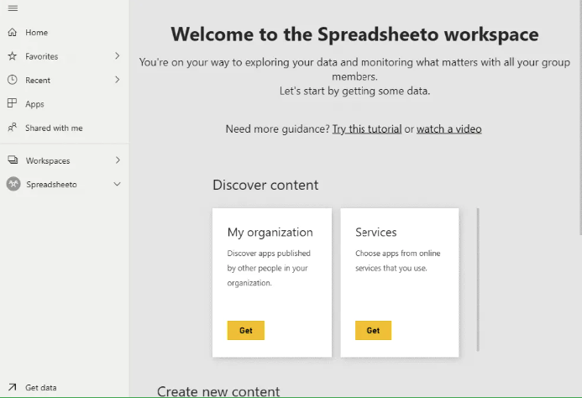
Create a Workspace
To get started, navigate to ‘Workspaces’ either by clicking on it in the left navigation pane or its icon if you’ve minimized the pane.
Next, select ‘Create a workspace’.
Power BI will prompt you to fill in your workspace details.
While choosing a name for your workspace, don’t use the same name.
Once you’re satisfied with the details, click ‘Save’.
Power BI will then display your team’s workspace.

Slide 40
Power BI Workspace Roles
Power BI workspaces come with role-based access to ensure that users can only perform the actions allowed by their specific roles.
The roles control what users can and cannot do within a workspace.
Role | Access
Admin | Admins have full control over the workspace. They can add or remove members, change roles, publish reports, and manage the workspace’s settings. Admins also have access to all content within the workspace.
Member | Members can create, edit, and view content in the workspace. They can also share reports and dashboards but cannot modify the workspace’s settings or manage access permissions.
Contributor | Contributors can create and modify content within the workspace but cannot delete it or change workspace settings. They can add reports and dashboards and edit or update datasets.
Viewer | Viewers can only view the content shared with them. They have no permissions to create, edit, or share reports and dashboards. This role is ideal for users who need access to reports without needing to modify them.

Slide 41

Why Power BI Workspaces?
Collaboration: Workspaces facilitate teamwork, allowing multiple people to contribute to data analysis and report creation.
Access Control: Workspace roles help to enforce proper access and control, ensuring that users can only interact with content based on their permissions.
Content Management: Workspaces streamline the management of reports, datasets, and dashboards in a central location.

Slide 42
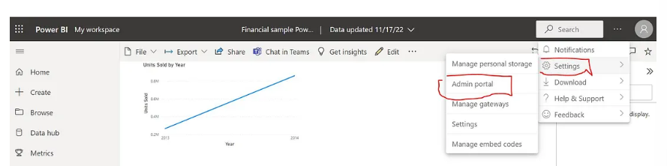
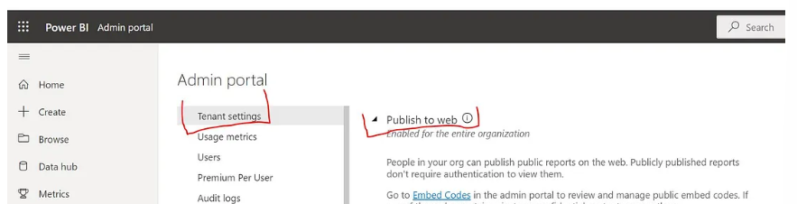
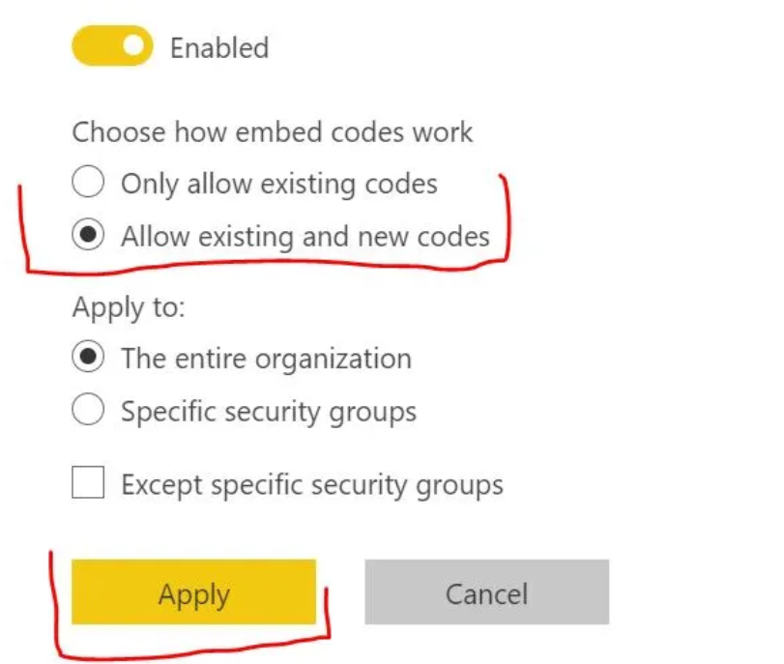
Enable Power BI Publish to web setting
On the top right-hand corner of the report page, click on the three dots.
This opens a dialog box. Click on Settings, then on Admin portal.
In this tenant setting page, click on Publish to web. Notice that “only allow existing codes” and “The entire organization” is highlighted.
To change the predefined settings, click on “Allowing existing and new codes” > “Apply”.

Slide 43
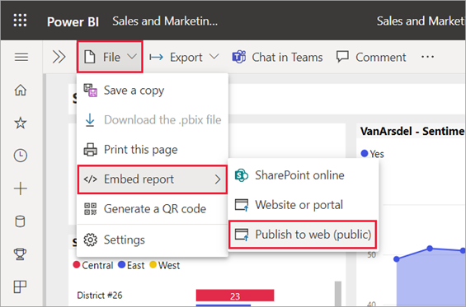
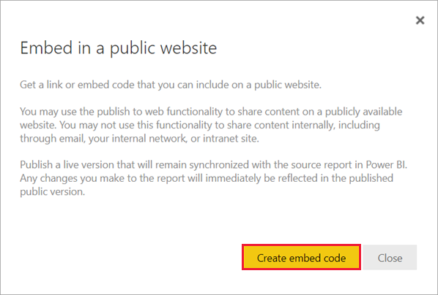
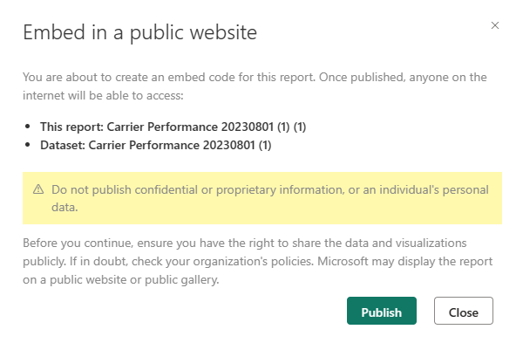
Publish to web
Open a report in a workspace that you can edit and select File > Embed report > Publish to web (public).
Review the dialog content and select Create embed code.
Review the warning and confirm that the data is okay to embed in a public website. If it is, select Publish.

Slide 44
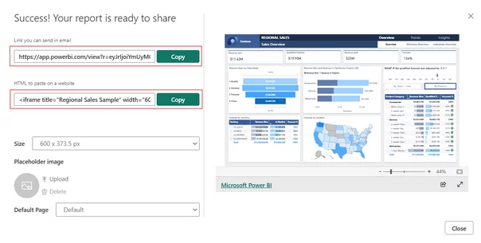
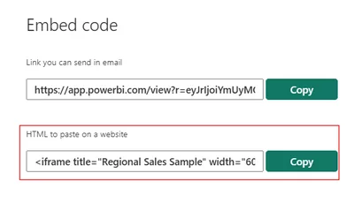

…
Copy the generated embed code or link.
In the Success dialog, you see a preview of how the report will look. Select the Size and Default page.
Paste the code into your website, blog, or social media post.
You can generate only one embed code for each report.

Slide 45
… Customize the embed code
Ratio | Size | Dimension (width x height)
16:9 | Small | 640 x 416 px
16:9 | Medium | 800 x 506 px
16:9 | Large | 960 x 596 px
4:3 | Small | 640 x 536 px
4:3 | Medium | 800 x 656 px
4:3 | Large | 960 x 776 px

Slide 46

… Limitations of Publish to Web
Public Access: Reports are accessible to anyone with the link.
No Access Control: No way to restrict who can view the report once published.
No Row-Level Security: Data filtering based on viewer identity is not supported.
No Suitable for Confidential Data: Highly discouraged for internal or sensitive content.

Slide 47
Different Share Methods
Aspect | Publish to Web | Share within Organization | Power BI Apps | Export to PDF/PPT | Power BI Embedded
Accessibility | Public (anyone with the link) | Private | Private | Public or Private | Private
Interactivity | Yes | Yes | Yes | No | Yes
Best for | Public sharing, broad audience | Internal collaboration, specific user groups | Organized sharing in teams | Static sharing, presentations | Custom applications, advanced embedding
Security | No access control, public | Access control within organization | Access control within organization | No access control once shared | Access control through custom application
Setup Complexity | Low | Low to Moderate | Moderate | Low | High (requires development skills)

Slide 48
Which one?
Scenario | Best Method | Why it Works?
Interactive dashboards for clients | Embed Reports | Secure, customizable, license-efficient
Executive summaries | Export/mail | Simple, repeatable, no training needed
Internal hub with resources | Link via URL | Centralizes all data-related tools
Publicly available data | Publish to Web | Easy to share, but low control
Cross-department analytics at scale | Embed Reports | Consistent UX with centralized governance

Slide 49
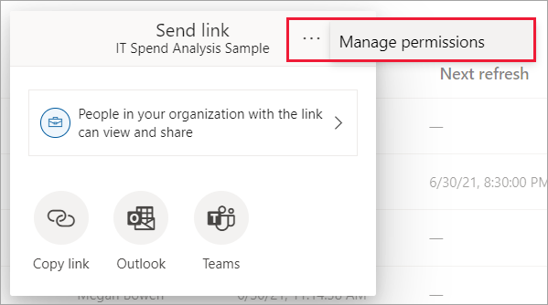

Manage Permissions
Select More options (…) in the sharing dialog, and then select Manage permissions.
In the Manage permissions pane, you can
Copy or change existing links
Grant or remove direct access
View pending requests and related content
Use Advanced for more options
Each report can’t have more than 1,000 sharing links. If you reach this limit, remove links for “Specific people” and grant those user's direct access.

Slide 50
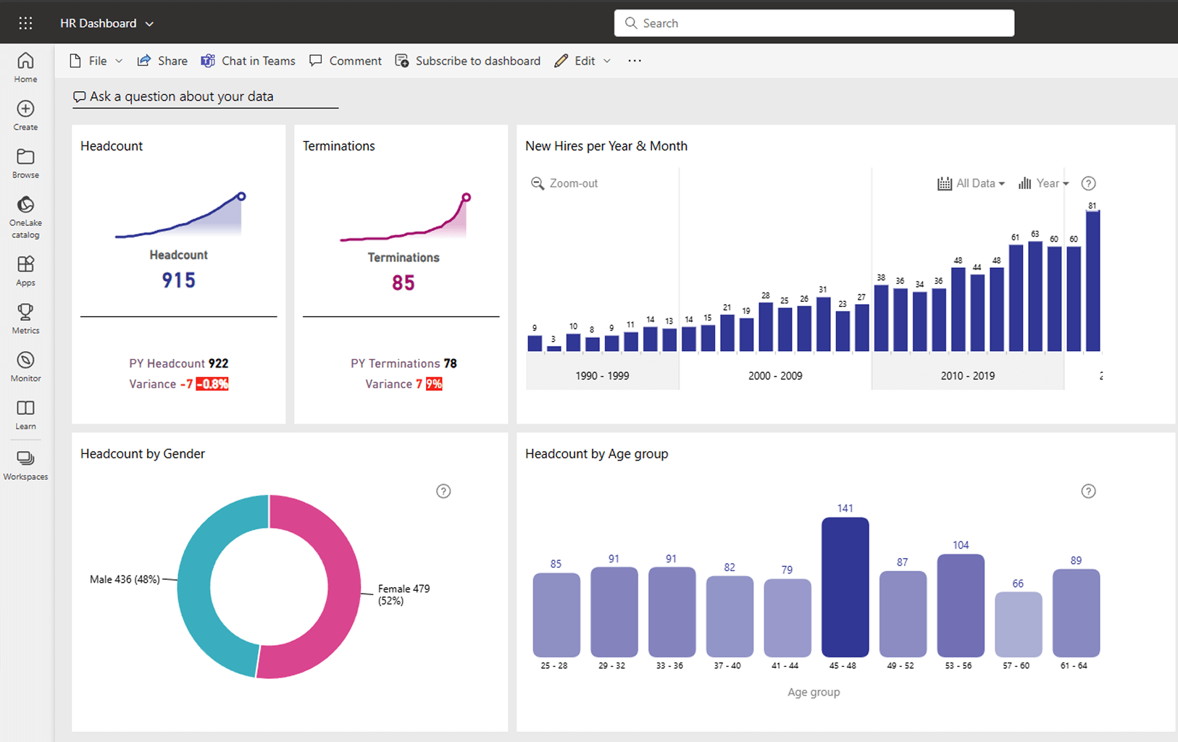
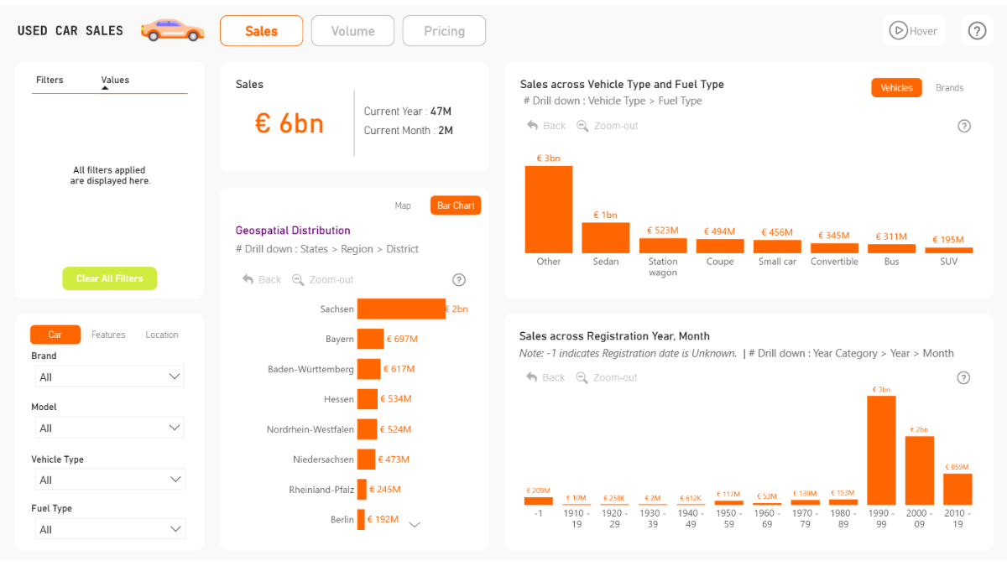
Dashboard & Reports
A Power BI dashboard is a single page view that brings together selected visuals from one or more reports. It is useful for combining information from different reports or subject areas into one place, making it easy to monitor key metrics at a glance.
A Power BI report is an interactive document that can contain or multiple pages and may use one or several data sources. Reports are designed for detailed analysis.

Slide 51
Dashboard Vs Reports
Dashboard | Report
Visual and interactive | Detailed and structured
Real-time or live data | Historical data
Quick overview | In-depth analysis
Charts and KPIs | Tables and text
Used by managers | Used by analysts/admins

